Slide 1

ECEN 3593-001 Computer Organization
Lecture #19
3 March 2021

Slide 2


Agenda
Class Announcements
Chapter 4 - Hazards

Slide 3
Class Announcements
Reading for the week
“Computer Organization and Design, The Hardware / Software Interface, RISC-V edition,” by David Patterson and John Hennessy
ISBN 978-0-12-812275-4
Chapter 4, “The Processor”
Phase 5 is in the 4%/day penalty stage (12% today)
Phase 6 Target Date Sunday, March 7 at 10:00 PM
Zoom Office Hours 2:00 to 3:00 today https://cuboulder.zoom.us/j/4317981384

Slide 4
Class Announcements
The Midterm Exam will be on Wednesday, March 17 in class
Homework #3 is posted
Due Tuesday, March 9 at 10:00 PM

Slide 5
Phase 6 Scoring
Schematic is 20% of total, Project is 80% of total
Schematic deductions the same as Phase 4, and are from the total score (not just the 20%)
Schematic – 1% bonus points per day before Target Date, maximum of 7% (all of the 20% schematic total)
Submit schematic early to get it reviewed
Project – 1% bonus points per day before Target Date
Both – 4% per day penalty after Target Date

Slide 6
Data Forwarding
Clock Cycle
CC0
CC1
CC2
CC3
CC4
CC5
CC6
CC7
CC8
sub x2, x1, x3
IM
RF
DM
RF
and x12, x2, x5
IM
RF
DM
RF
or x13, x6, x2
IM
RF
DM
RF
add x14, x2, x2
IM
RF
DM
RF
sd x15, 100(x2)
IM
RF
DM
RF

Slide 7
Detecting the need to forward
Pass register indices along pipeline
e.g., ID/EX.RegisterRs1 = register index for Rs1 sitting in ID/EX pipeline register
ALU operand register numbers in EX stage are given by
ID/EX.RegisterRs1, ID/EX.RegisterRs2 (r_ex_rs1 and r_ex_rs2)

Slide 8
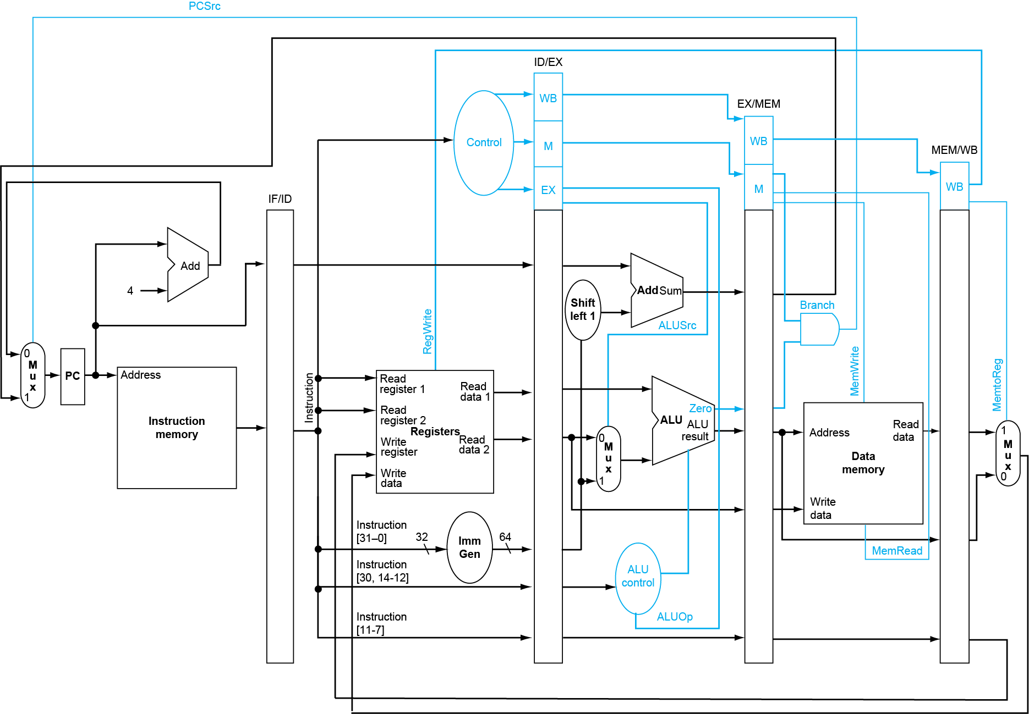
Pipeline Control
Pass necessary information down the pipeline
Note that rd is already passed down the pipeline

Slide 9
Detecting the need to forward
Pass register numbers along pipeline
e.g., ID/EX.RegisterRs1 = register number for Rs1 sitting in ID/EX pipeline register
ALU operand register numbers in EX stage are given by
ID/EX.RegisterRs1, ID/EX.RegisterRs2 (r_ex_rs1 and r_ex_rs2)
Data hazards when
1a. EX/MEM.RegisterRd (r_me_rd) = ID/EX.RegisterRs1
1b. EX/MEM.RegisterRd (r_me_rd) = ID/EX.RegisterRs2
2a. MEM/WB.RegisterRd (r_wb_rd) = ID/EX.RegisterRs1
2b. MEM/WB.RegisterRd (r_wb_rd) = ID/EX.RegisterRs2
Fwd from ME pipeline reg
Fwd from WB pipeline reg

Slide 10
Detecting the need to forward
But only if forwarding instruction will write to a register!
EX/MEM.RegWrite, MEM/WB.RegWrite = 1
And only if Rd for that instruction is not x0
EX/MEM.RegisterRd ≠ 0, MEM/WB.RegisterRd ≠ 0

Slide 11
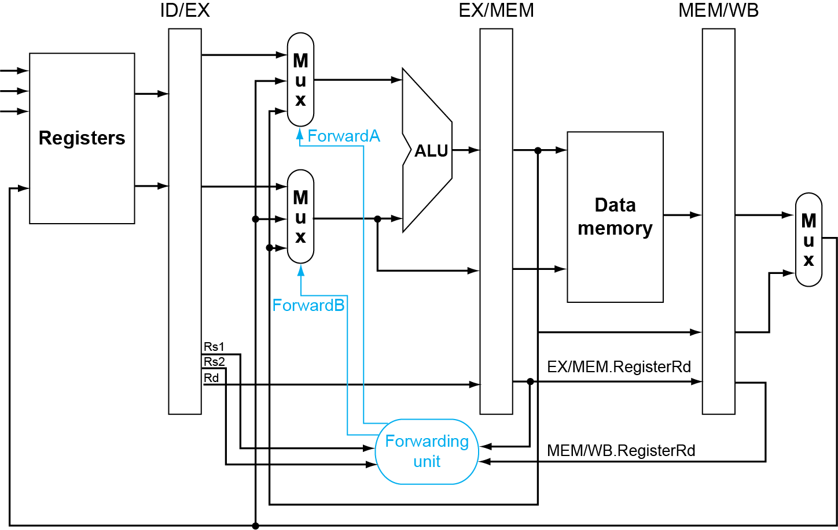
Forwarding paths
Mux on src1 side of ALU
Mux on src2 side of ALU
Forwarding control logic

Slide 12
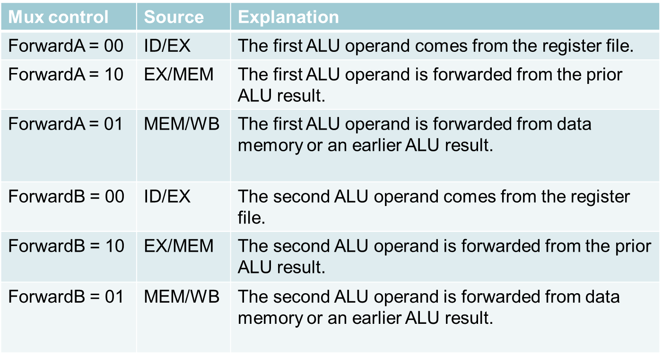
Forwarding conditions

Slide 13
Double Data Hazard
Consider the sequence:
add x1,x1,x2 add x1,x1,x3 add x1,x1,x4
Both hazards occur
Want to use the most recent
Revise MEM/WB hazard condition
Only forward if EX/MEM hazard condition isn’t true
x1 forwarded from the EX/MEM register
x1 forwarded from the EX/MEM register, not from the MEM/WB register

Slide 14
Revised Forwarding condition
MEM hazard
if (MEM/WB.RegWrite
and (MEM/WB.RegisterRd ≠ 0)
and not(EX/MEM.RegWrite and (EX/MEM.RegisterRd ≠ 0)
and (EX/MEM.RegisterRd = ID/EX.RegisterRs1))
and (MEM/WB.RegisterRd = ID/EX.RegisterRs1)) ForwardA = 01
if (MEM/WB.RegWrite
and (MEM/WB.RegisterRd ≠ 0)
and not(EX/MEM.RegWrite and (EX/MEM.RegisterRd ≠ 0)
and (EX/MEM.RegisterRd = ID/EX.RegisterRs2))
and (MEM/WB.RegisterRd = ID/EX.RegisterRs2)) ForwardB = 01

Slide 15
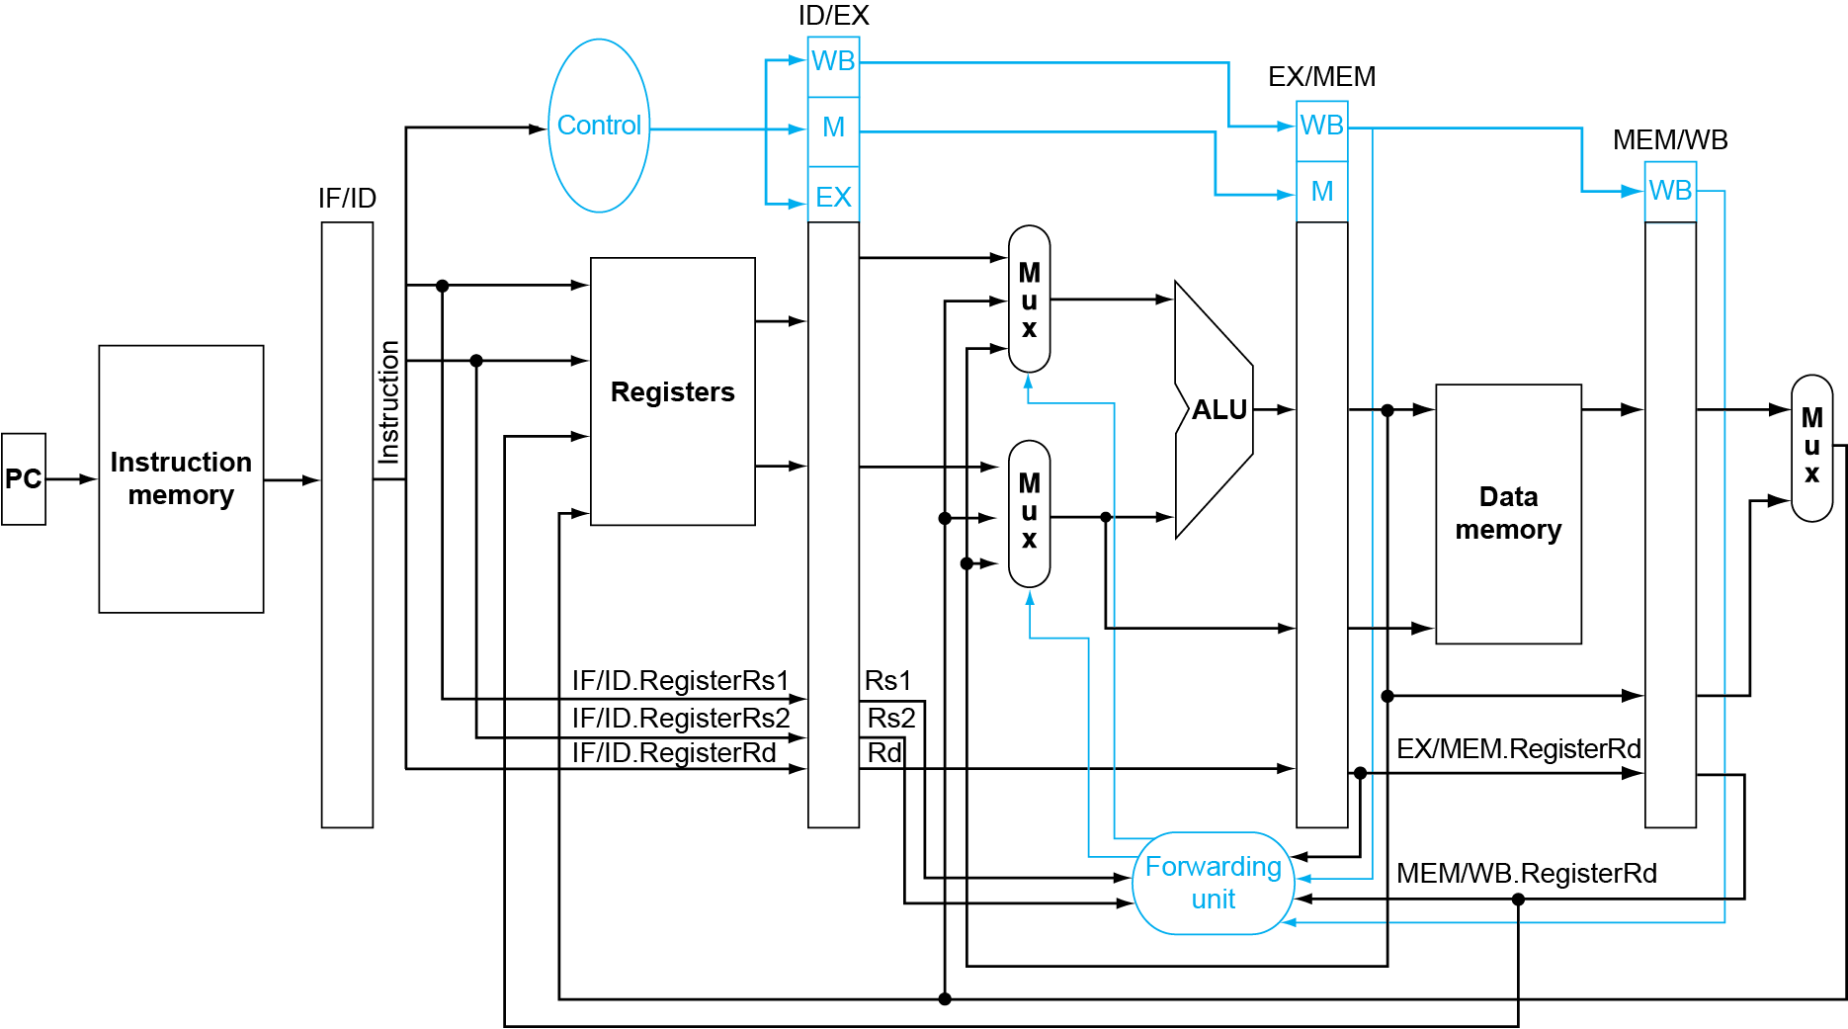
Forwarding paths

Slide 16
Load Data Hazard
Clock Cycle
CC0
CC1
CC2
CC3
CC4
CC5
CC6
CC7
CC8
ld x12, 100(x3)
IM
RF
DM
RF
add x1, x12, x2
nop
IM
RF
DM
RF
stall
add x1, x12, x2
IM
RF
DM
RF
What type of forwarding is then used here? (Poll)
MEMWB
IM
RF
DM
RF
IM
RF
DM
RF

Slide 17
Load-Hazard Detection
Check when using instruction is decoded in ID stage
ALU operand register numbers in ID stage are given by
IF/ID.RegisterRs1, IF/ID.RegisterRs2 (s_id_rs1, s_id_rs2)
Load-use hazard when
ID/EX.MemRead and ((ID/EX.RegisterRd (r_ex_rd) = IF/ID.RegisterRs1) or (ID/EX.RegisterRd (r_ex_rd) = IF/ID.RegisterRs2))
If detected, stall and insert bubble

Slide 18
How to insert a bubble and stall the pipeline
Force control values in ID/EX register to 0
EX forced to a NOP (no-operation)
Inserting a “bubble” in EX

Slide 19
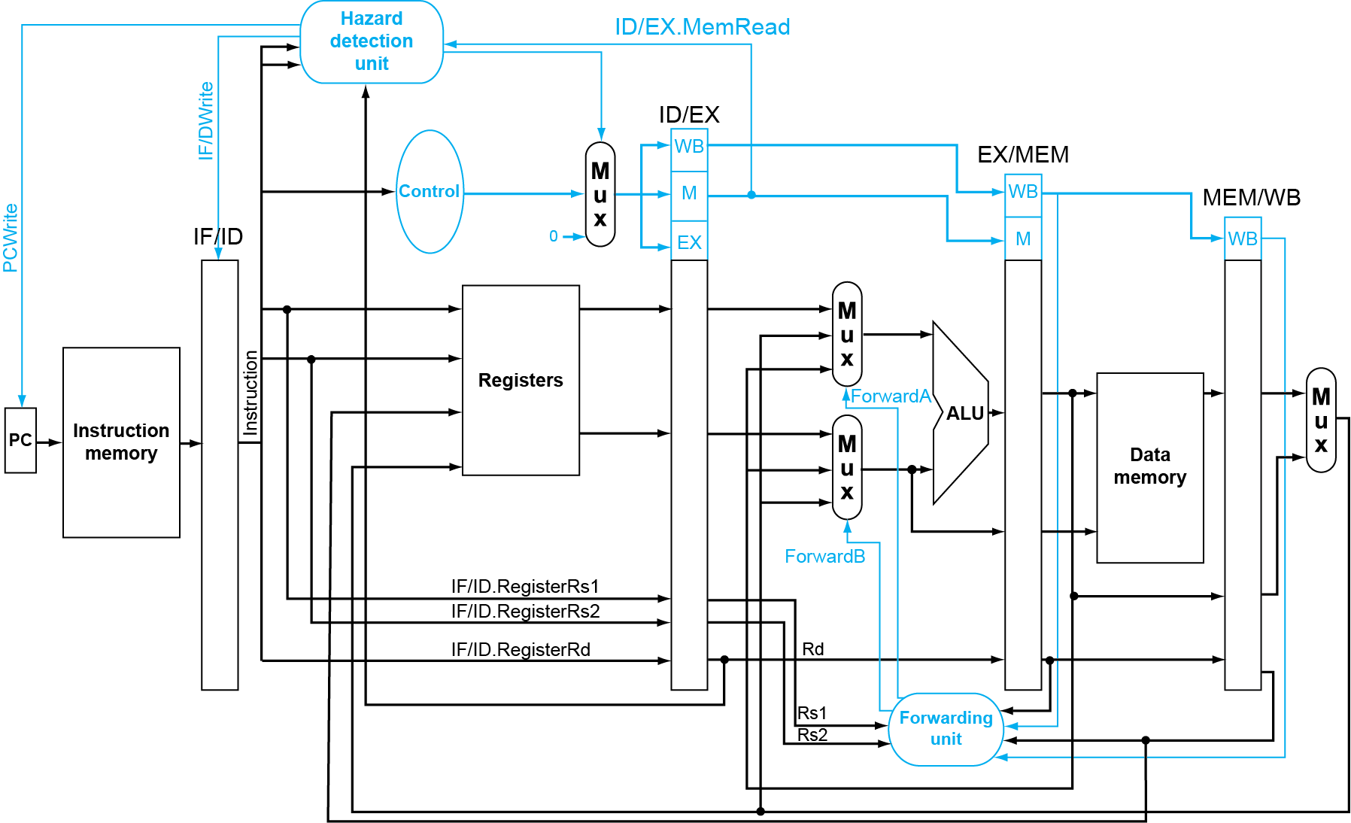
Data path with hazard detection

Slide 20
Inserting a bubble
Force control values in ID/EX register to 0
EX forced to a NOP (no-operation)
In Codasip we do this by asserting s_ex_clear
0 for branch control will disable the branch AND gate
0 for MemRead will disable load operation
0 for MemWrite will disable store operation
0 for RegWrite will prevent an update to the Register file
This is why the first enum in Codasip must be NOP

Slide 21
How to insert a bubble and stall the pipeline
Force control values in ID/EX register to 0
EX forced to a NOP(no-operation)
Prevent update of PC and IF/ID register
Using instruction is decoded again
Following instruction is fetched again
1-cycle stall allows MEM to read data for ld
Can subsequently transfer to EX stage
Inserting a “bubble”
Stalling the pipeline before the decode stage

Slide 22
Load Hazard Pipeline Flow
IF
ID
EX
ME
WB
ld x1, -20(x2)
add x2, x1, x3
Clock 1
ld
pc-1
pc-2
pc-3
pc-4
add
ld
pc-1
pc-2
pc-3
Clock 2
pc+1
add
ld
pc-1
pc-2
Clock 3
bubble
stall
hazard
proceed
Clock 4
pc+1
add
nop
ld
pc-1
pc+2
pc+1
add
nop
ld
Clock 5
MEMWB forwarding

